Slide 1

Statistical learning
http://compcogscisydney.org/psyc3211/
A/Prof Danielle Navarro
d.navarro@unsw.edu.au
compcogscisydney.org

Slide 2
Where are we?
L1: Connectionism
L2: Statistical learning
L3: Semantic networks
L4: Wisdom of crowds
L5: Cultural transmission
L6: Summary

Slide 3
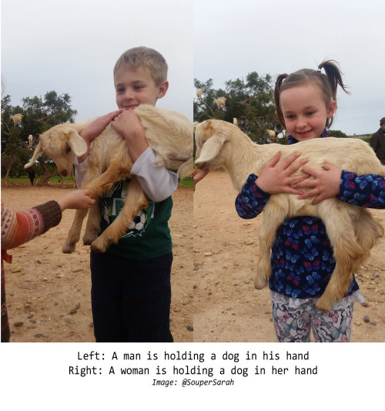
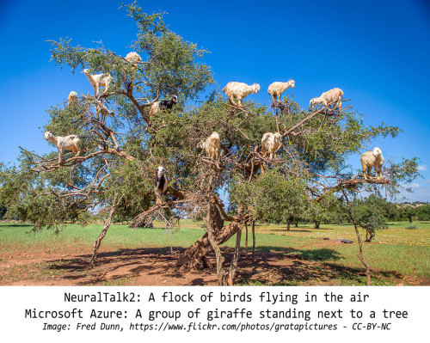
Why do networks get this wrong?
A goat being held by a child is labelled a “dog”
Goats in trees become birds or giraffes
http://aiweirdness.com/post/171451900302/do-neural-nets-dream-of-electric-sheep

Slide 4
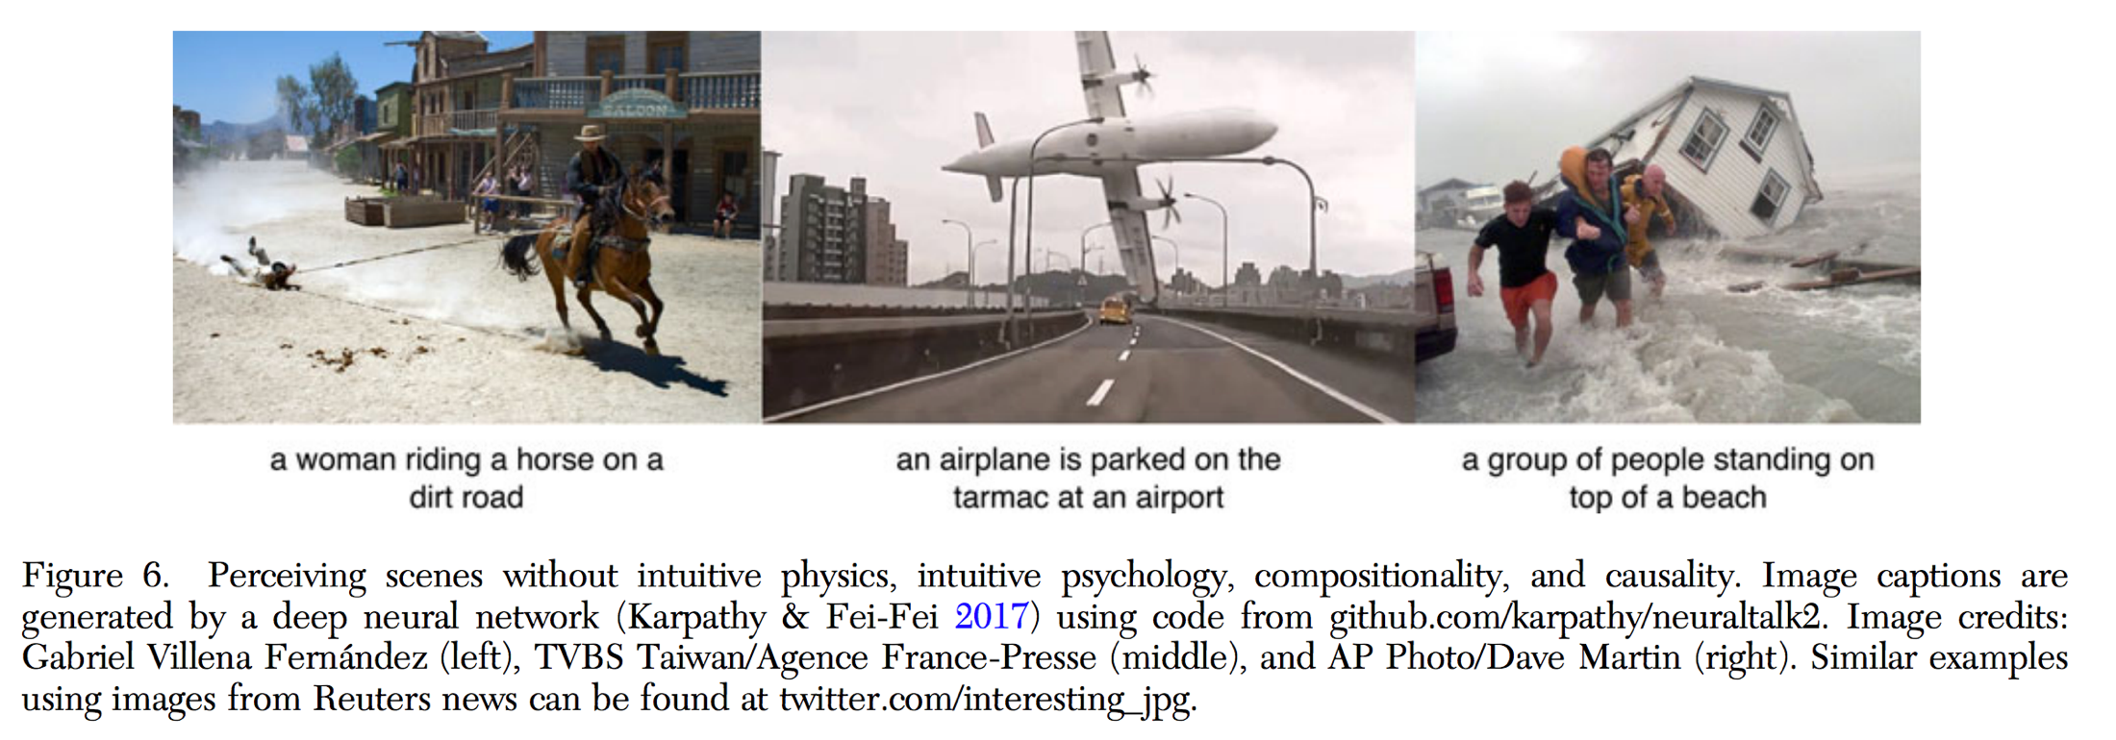
Why do networks get this wrong?
Lake, B. M., Ullman, T. D., Tenenbaum, J. B., & Gershman, S. J. (2017). Building machines that learn and think like people. Behavioral and Brain Sciences, 40.

Slide 5
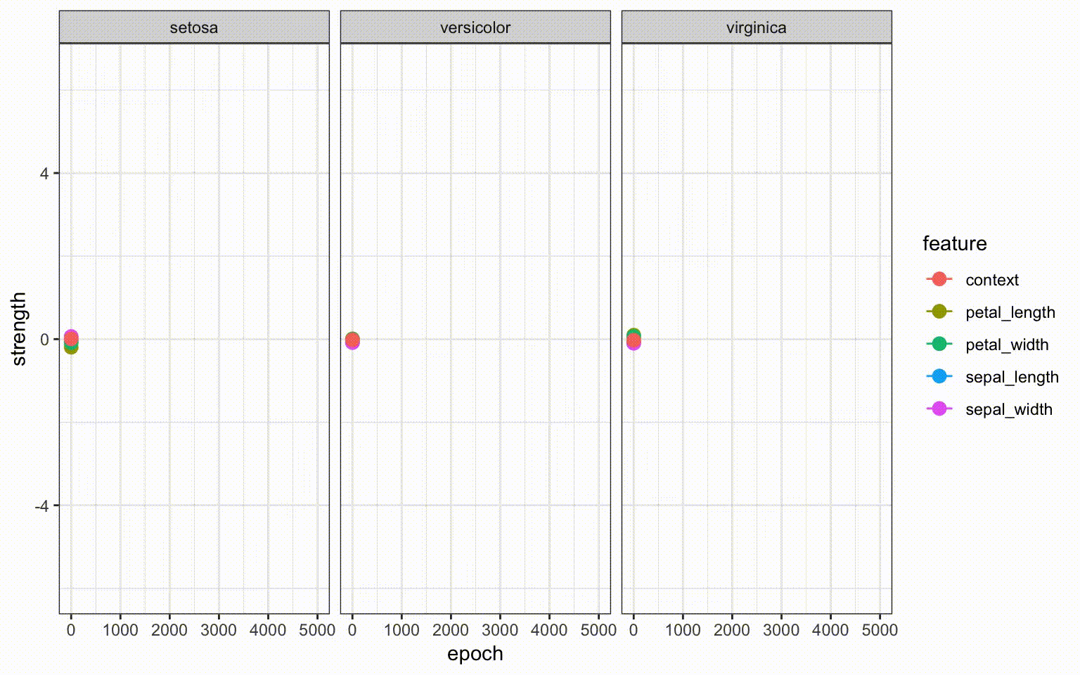

Learning slow…
Each epoch is about 150 trials
This learning unfolds over 750,000 episodes

Slide 6

Learning fast…
Here is a letter written in an alien alphabet
Please write down nine more examples

Slide 7
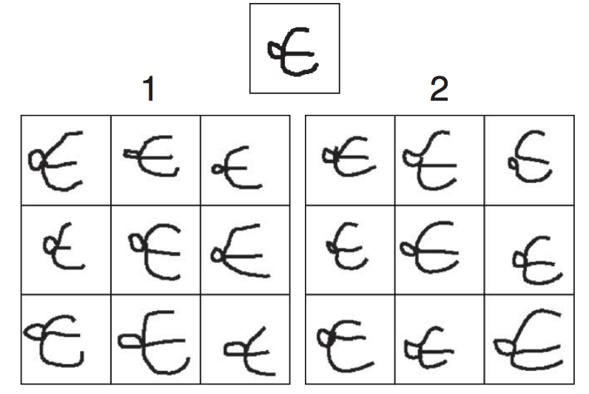
A “Turing test”: Which is the human and which is the machine?
The puzzle: How does a human (or machine) do this “one-shot generalization” if learning is slow???

Slide 8
Structure of the lecture
What is Bayesian reasoning?
Two examples of psychological models
Coincidence detection
Perceptual magnet effect
Linking Bayesian cognitive models with Bayesian machine learning

Slide 9
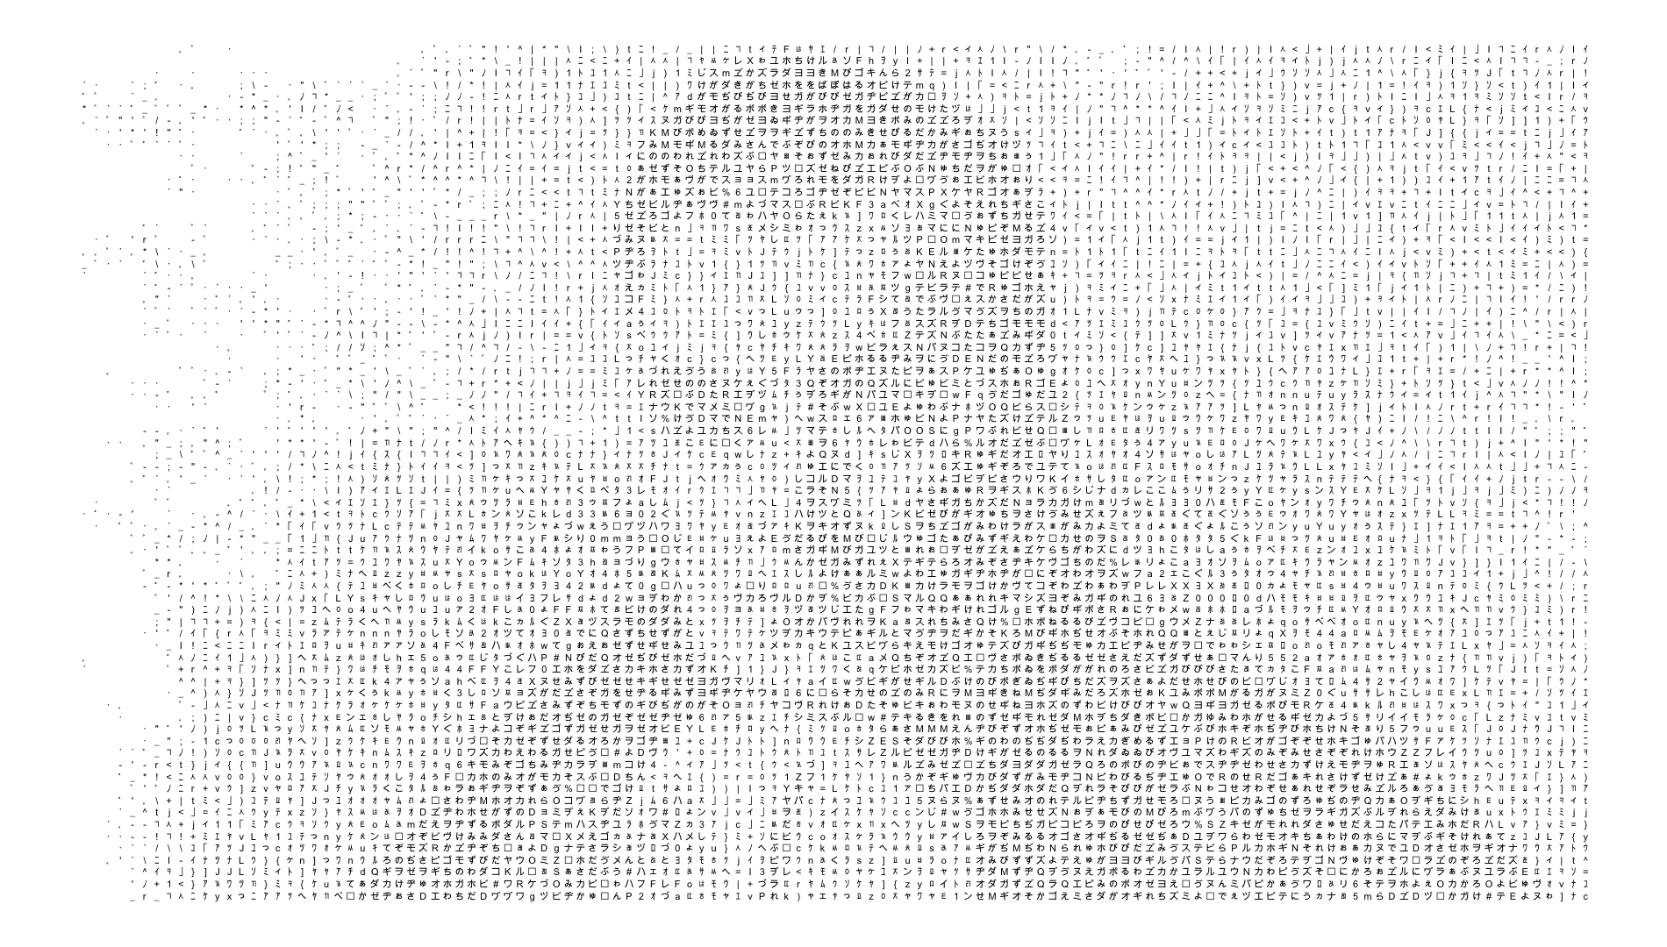
Learning with Bayes’ rule

Slide 10
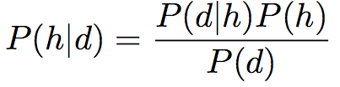

P(d|h) : the likelihood of observing d if h is true
P(h) : the prior probability that h is true
P(h|d) : the posterior probability that h is true
P(d) : the probability of the data
But what does this any of this gibberish mean?????

Slide 11
What happened here? An example of Bayesian reasoning

Slide 12
There are many possible explanations
dropped a wine glass
broke a window
psychic explosion
earthquake
a wizard did it

Slide 13
Let’s consider two of them
Someone dropped a wine glass
Kids broke the window

Slide 14

Prior beliefs
P(h) is the prior, and refers to the inherent plausibility of h as an explanation, before observing any evidence
= 1/10
Before learning anything else I think “wine glass dropping” is 10 times more plausible than “broken window”
Relative plausibility of two hypotheses is the ratio between their prior probabilities, the prior odds

Slide 15
Some data
d = there is a cricket ball next to the broken glass

Slide 16
Likelihood of the data
P(d|h) is the likelihood, and describes the probability that we would have observed data d if the hypothesis h were true
When I drop a wine glass…
… It’s very unlikely that I just happen to do so right next to a cricket ball
P(d|h) = 0.001

Slide 17
Likelihood of the data
P(d|h) is the likelihood, and describes the probability that we would have observed data d if the hypothesis h were true
When the kids break a window…
… It’s not at all uncommon for a cricket ball to end up near the glass
P(d|h) = 0.15

Slide 18
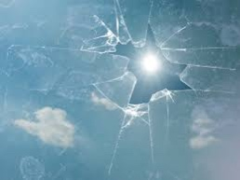

Likelihood of the data
P(d|h) is the likelihood, and describes the probability that we would have observed data d if the hypothesis h were true
0.15
=
= 150
0.001
The data (cricket ball) are 150 times more likely under the “broken window” hypothesis
Relative probability of the data according to the hypotheses is the evidentiary value of the data, referred to as the likelihood ratio (or the Bayes factor)

Slide 19
Posterior beliefs
P(h|d) is the posterior, and refers to the “updated” plausibility of h as an explanation, after observing the evidence
Posterior odds
Likelihood ratio
Prior odds
= 15
= 150
= .1
In light of the evidence, I now think that window-breaking is 15 times more plausible than dropped-wine-glass

Slide 20

But I have many hypotheses?
…

Slide 21
Prior probabilities for all hypotheses
0.01
0.01
0.01
We have a set of hypotheses h, (called a hypothesis space) each of which has some degree of prior plausibility
0.80
0.08
…
There is a conservation of belief rule… if we listed all the hypotheses and assessed their prior plausibility, they would have to sum to 1

Slide 22
Likelihoods for the data, according to each hypothesis
0.5
0.03
0.001
…
Every hypothesis supplies a likelihood… the probability of the data (cricket ball) if that hypothesis is correct

Slide 23
Prior x Likelihood
To calculate posterior plausibility, hypotheses are “scored” by multiplying the prior plausibility by the likelihood of the data
My posterior belief P(h|d) in h now that I’ve seen data d…
… the prior belief P(h) multiplied by the likelihood P(d|h)
… is proportional to …
(we’ll come back to that)

Slide 24
Prior x Likelihood
To calculate posterior plausibility, hypotheses are “scored” by multiplying the prior plausibility by the likelihood of the data
The posterior must satisfy the conservation of belief, and must sum to 1
The prior must satisfy the conservation of belief, and must sum to 1

Slide 25
Bayes’ rule
Conservation of belief means that we have to divide by the sum, taken over all hypotheses

Slide 26
Bayes’ rule
That big sum is referred to as the probability of the data P(d)
(still confused? the tutorial exercise will go through this!)

Slide 27

Bayesian models of cognition
Example1: When is a coincidence more than a coincidence?

Slide 28




Mere coincidence? Or something else?
You are travelling overseas and meet your next door neighbor
You flip a coin 10 times and it comes up heads every time
A stage magician flips a coin10 times and it comes up heads every time
Five people are having a conversation and they were all born on a Monday

Slide 29
Coincidences model
(Griffiths & Tenenbaum 2007)
Argues that we evaluate two hypotheses:
h₁: the observations are due to chance outcomes from an unstructured process
h₂: the observations are the product of a structured process

Slide 30
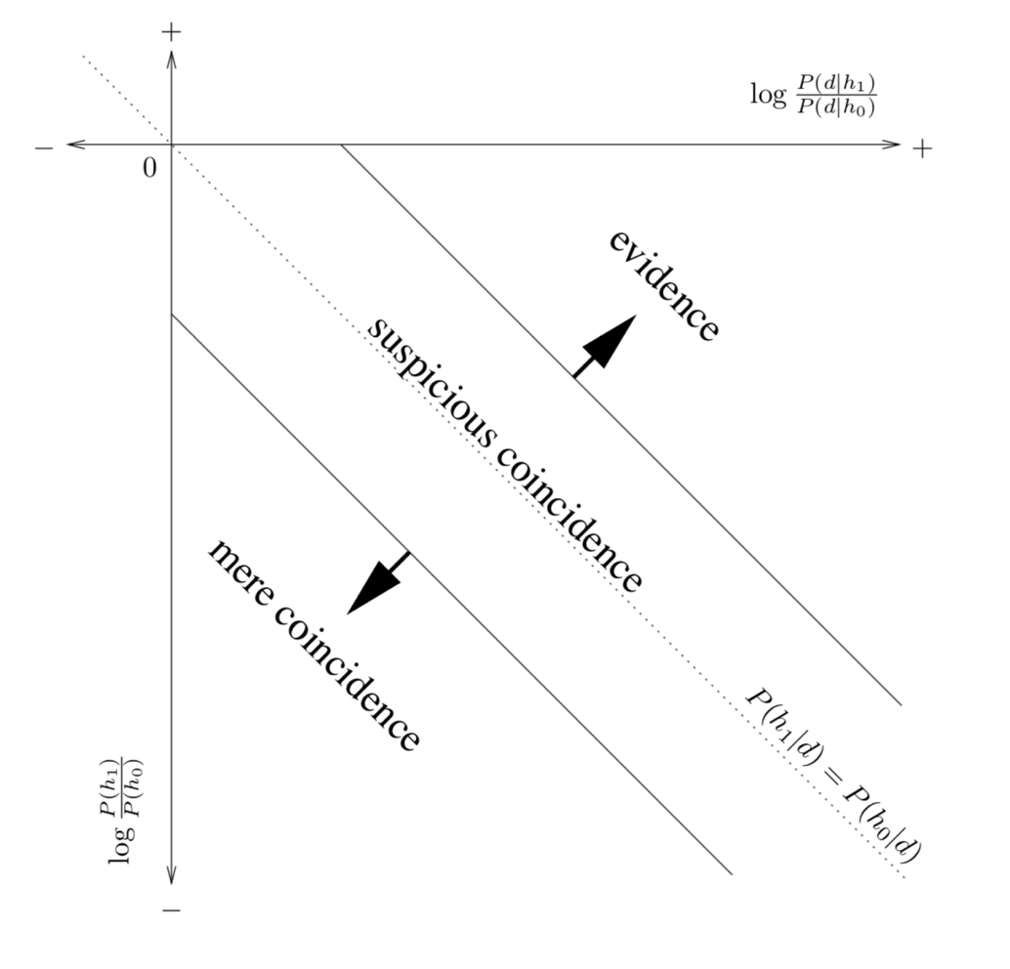
Coincidences model
(Griffiths & Tenenbaum 2007)
(logarithm of) the posterior odds
(logarithm of) the prior odds

Slide 31
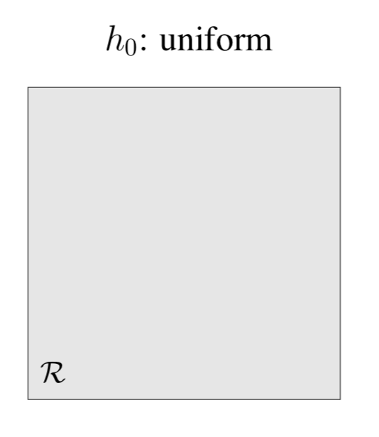
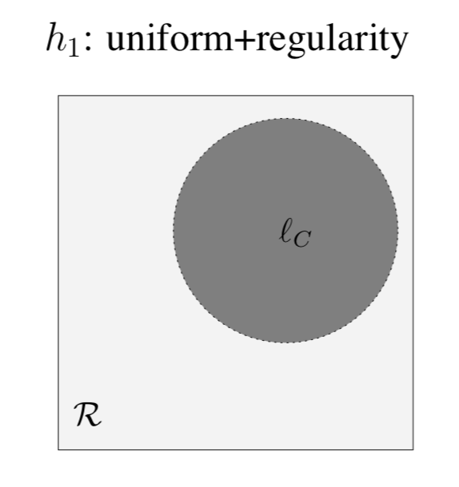
Coincidences in space
When is spatial clustering “mere coincidence”?

Slide 32
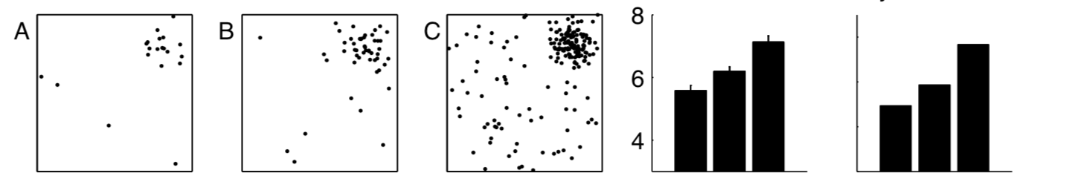
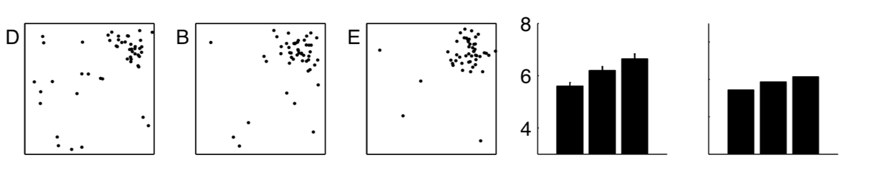
Coincidences in space
Increasing the total number of points….
Human
Model
Changing the proportion of points…
Human
Model

Slide 33
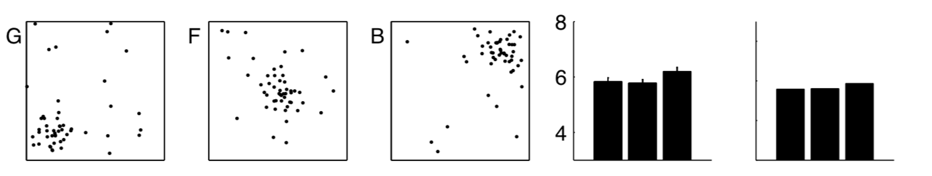
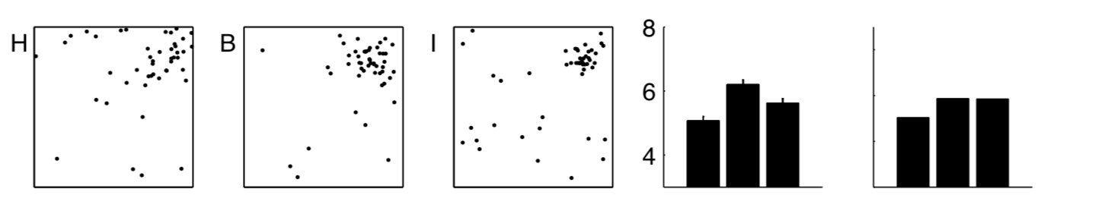
Coincidences in space
Moving the points around…
Human
Model
Changing the spread…
Human
Model

Slide 34
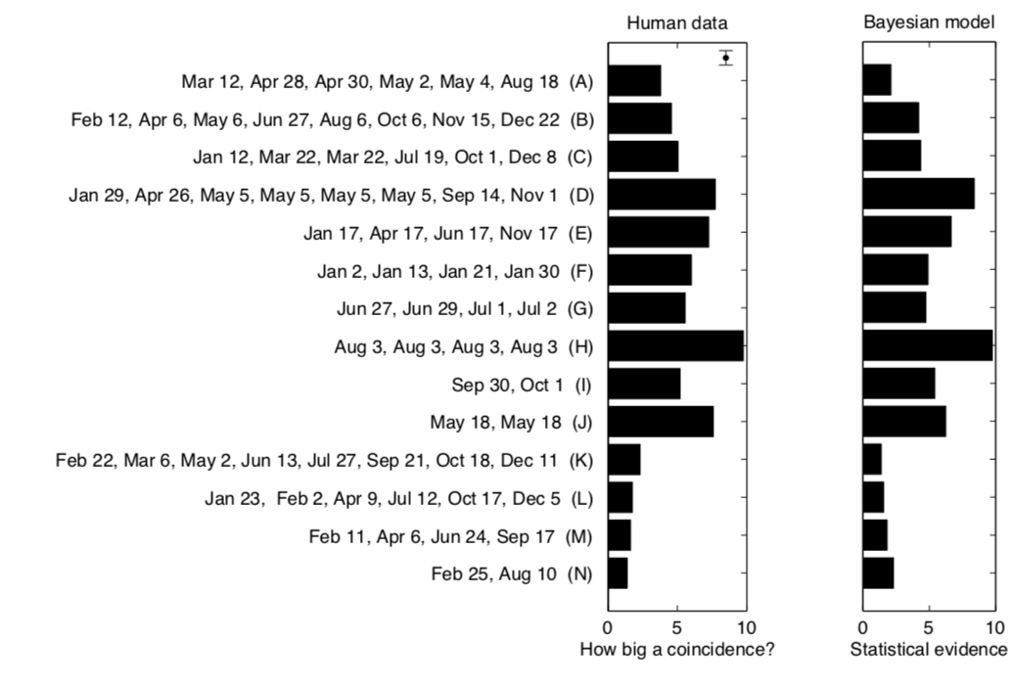
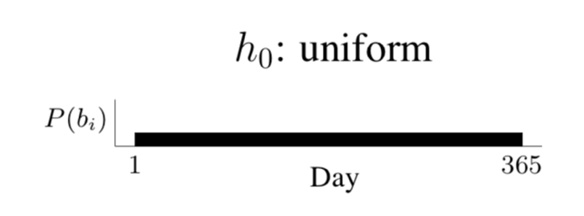
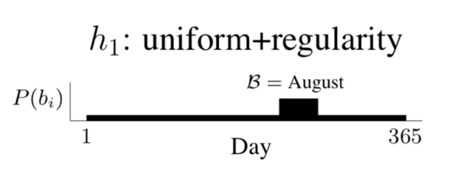
Coincidences in time

Slide 35
But it’s complicated…
(Tauber et al 2017)
A group of scientists investigating genetic engineering have conducted a series of experiments testing drugs that influence the development of rat fetuses. All of these drugs are supposed to affect the sex chromosome: they are intended to affect whether rats are born male or female. The scientists tested this claim by producing 100 baby rats from mothers treated with the drugs. Under normal circumstances, male and female rats are equally likely to be born. The results of these experiments are shown below: The identities of the drugs are concealed with numbers, but you are given the number of times male or female rats were produced by mothers treated with each drug.

Slide 36
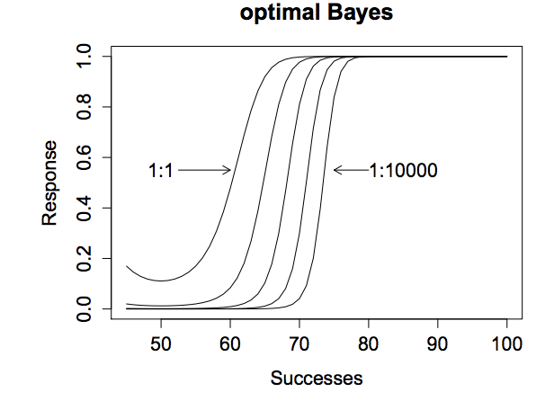
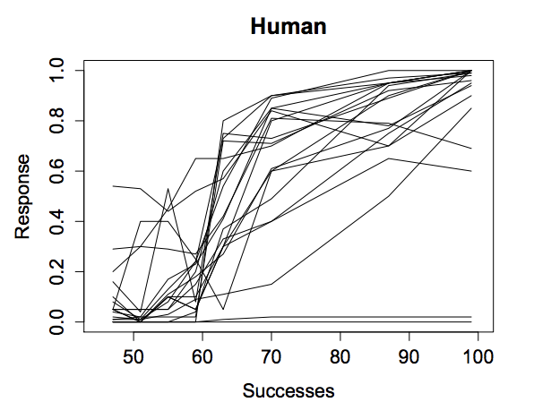
But it’s complicated…
(Tauber et al 2017)
Empirical data for individual subjects are systematically flatter… we revise our beliefs more slowly when evidence arrives
If people used the “optimal” statistical model to update data curves should look like this…
(very old phenomenon… conservatism in belief updating)

Slide 37
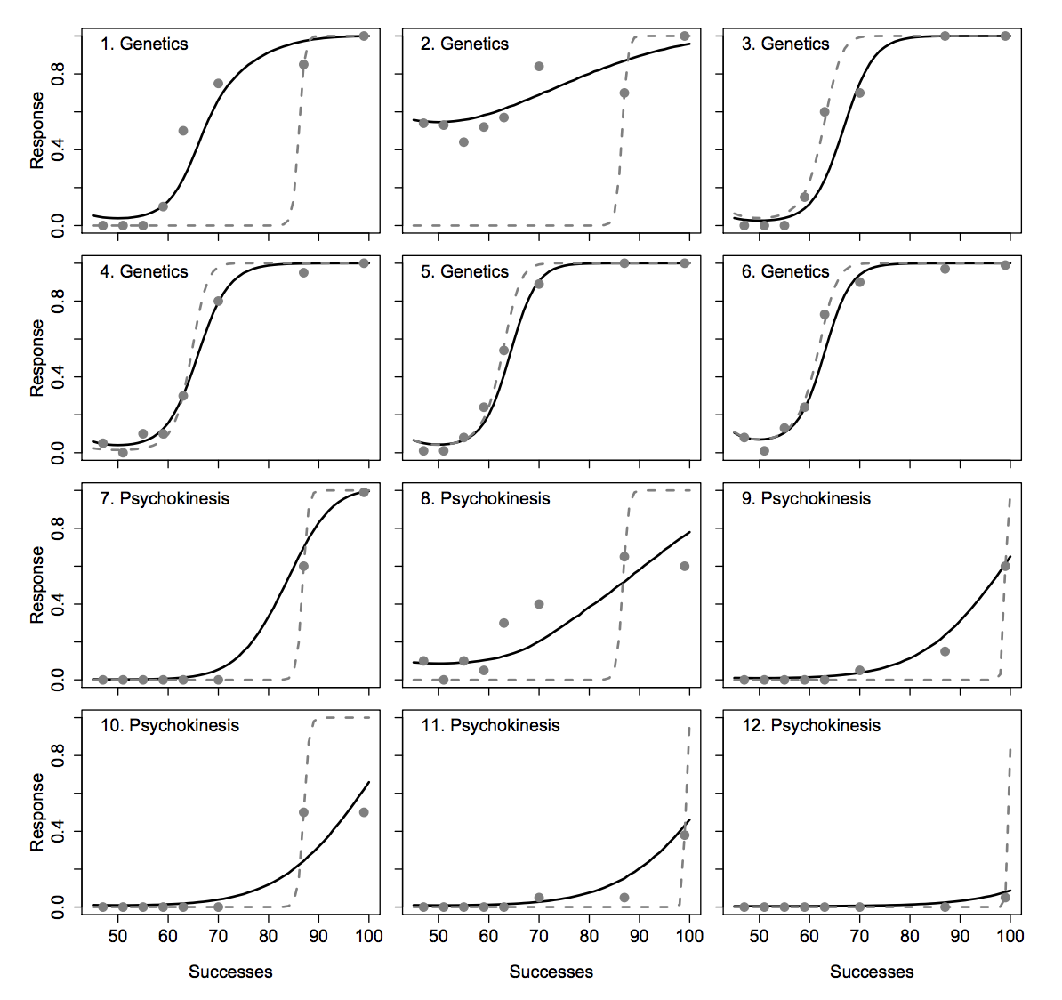
But it’s complicated…
(Tauber et al 2017)
People do have stronger prior biases to believe that a “genetic” experiment works (as opposed to “psychokinesis”) but…
… we also apply a more conservative Bayesian belief revision rule when the data are at odds with our priors!

Slide 38
Bayesian models of cognition
Example 2: How do categories influence perception?

Slide 39
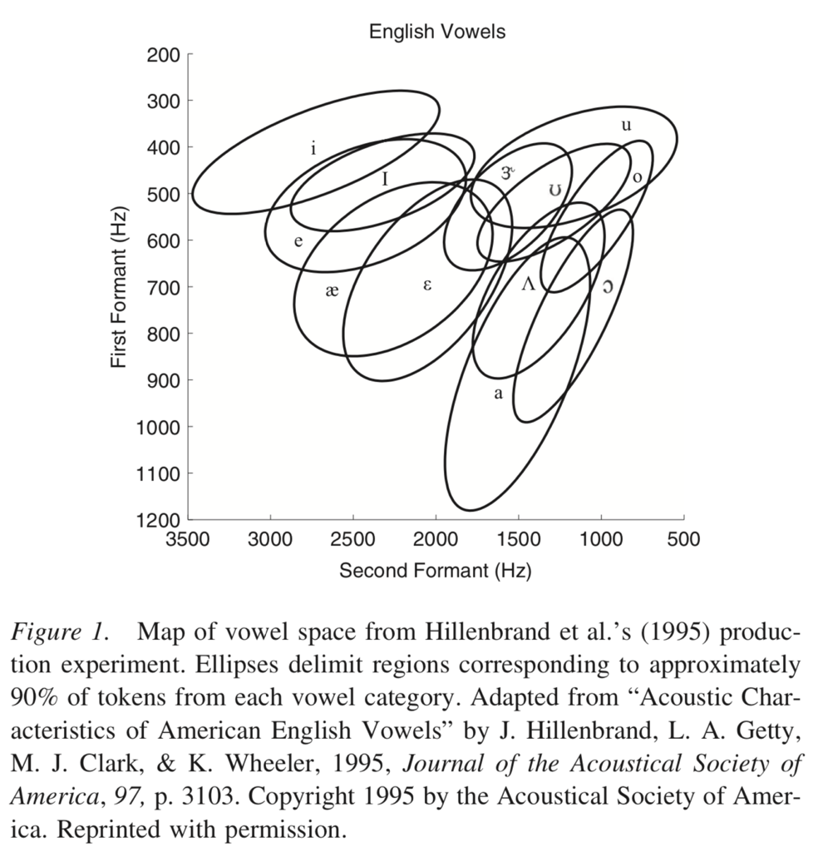
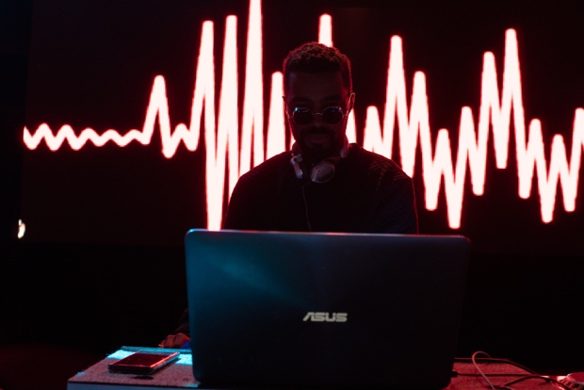
Bayesian perceptual magnets
(Feldman et al 2009)
We have knowledge about the perceptual categories that are used in our language
Sensory input is noisy, and it’s often hard to decode speech sounds

Slide 40
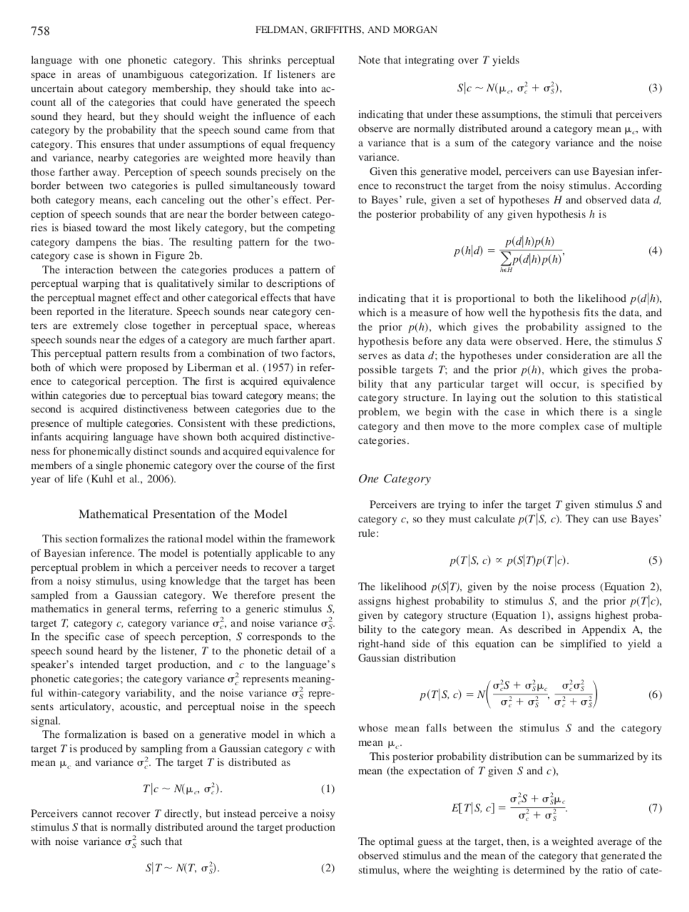
Bayesian perceptual magnets
(Feldman et al 2009)
Blah blah blah lots of fancy maths because they are smart
Short version:
Knowledge about the perceptual/linguistic categories supplies a prior P(h) for what the possible speech sound could have been
Sensory system supplies the likelihood P(d|h) that we would receive this input given any speech sound

Slide 41
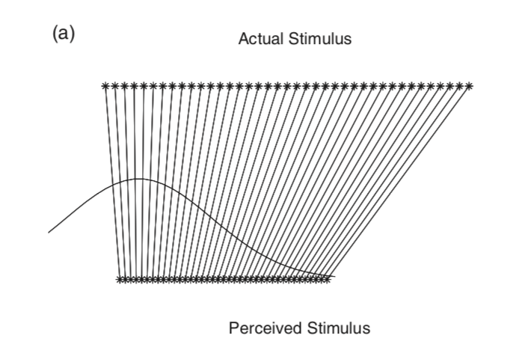
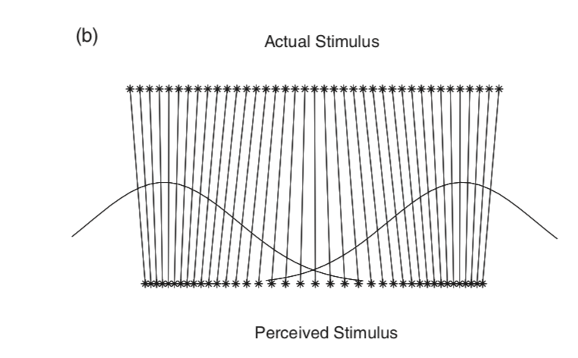
Bayesian perceptual magnets
(Feldman et al 2009)
The categorical knowledge shapes the perceived sound…
The predicted distortion pattern depends on the locations of the categories…

Slide 42
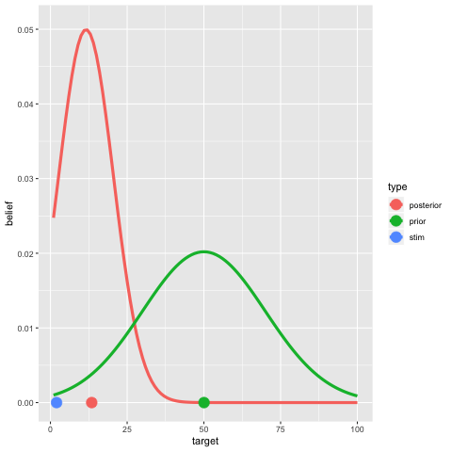
Bayesian perceptual magnets
(Feldman et al 2009)
Example 1:
Moving the stimulus relative to the category

Slide 43
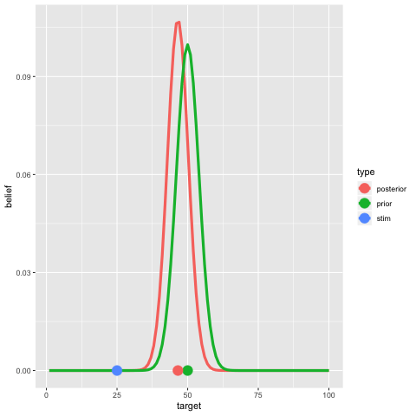
Bayesian perceptual magnets
(Feldman et al 2009)
Example 2:
Changing the strength of prior knowledge relative to the noise in the environment

Slide 44
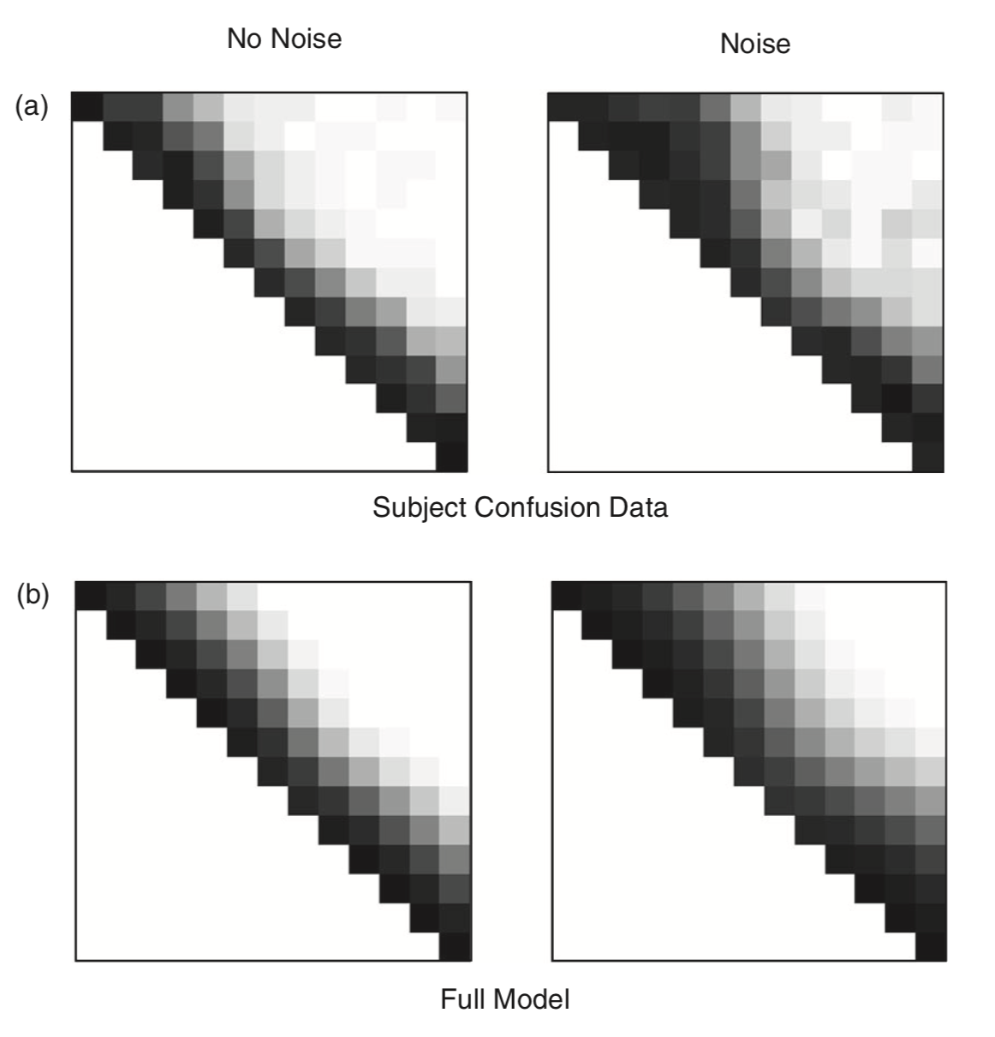
Bayesian perceptual magnets
(Feldman et al 2009)
The perceptual magnet effect is strongest in moderately noisy environments, roughly in accordance with model predictions
(Needs to be clean enough that you can work out what the category is supposed to be but not so noisy that you can’t hear anything)

Slide 45
Connecting Bayesian cognitive models with Bayesian machine learning

Slide 46
The structure problem
A goat being held by a child is labelled a “dog”
Goats in trees become birds or giraffes

Slide 47
The structure problem
Even though it is comparatively simple, this is still a structured object.
It has distinct parts, they are related to one another
There is a production method (writing) that tells you what the relations are
Human reasoning about these concepts exploits this knowledge
How do we build theories that do that?

Slide 48
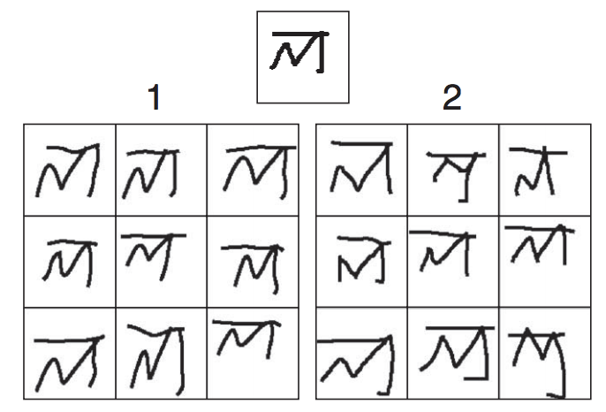
Human level concept learning with “Bayesian program induction”
(Lake et al 2015)
Notes:
Machine = 1

Slide 49
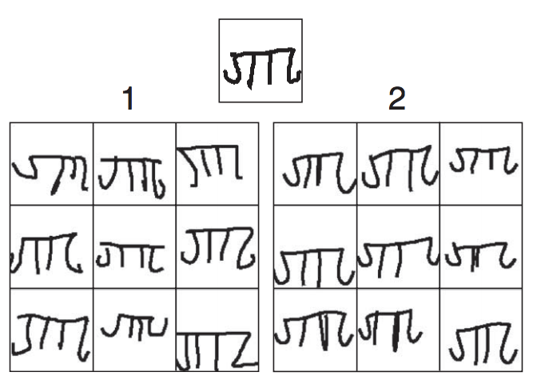
Notes:
Machine = 2

Slide 50
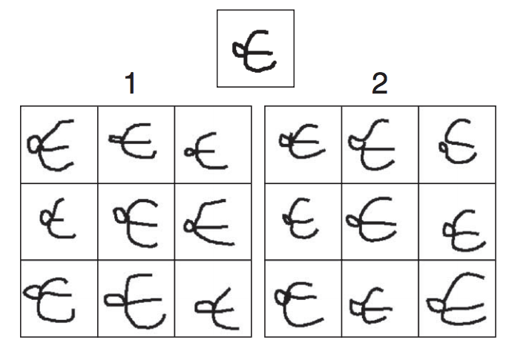
Notes:
Machine = 2

Slide 51
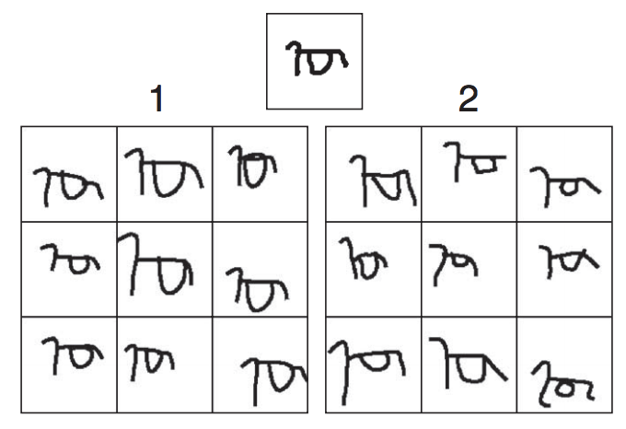
Notes:
Machine = 1

Slide 52
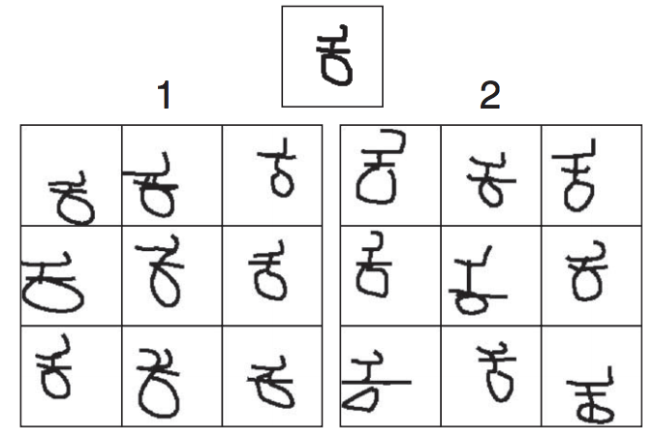
Notes:
Machine = 1

Slide 53
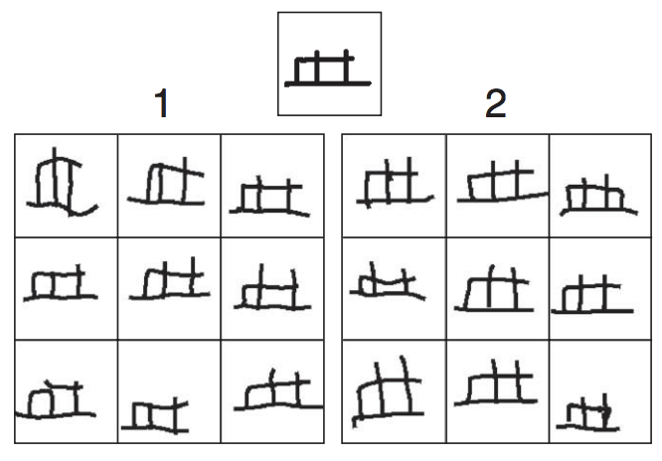
Notes:
Machine = 1

Slide 54
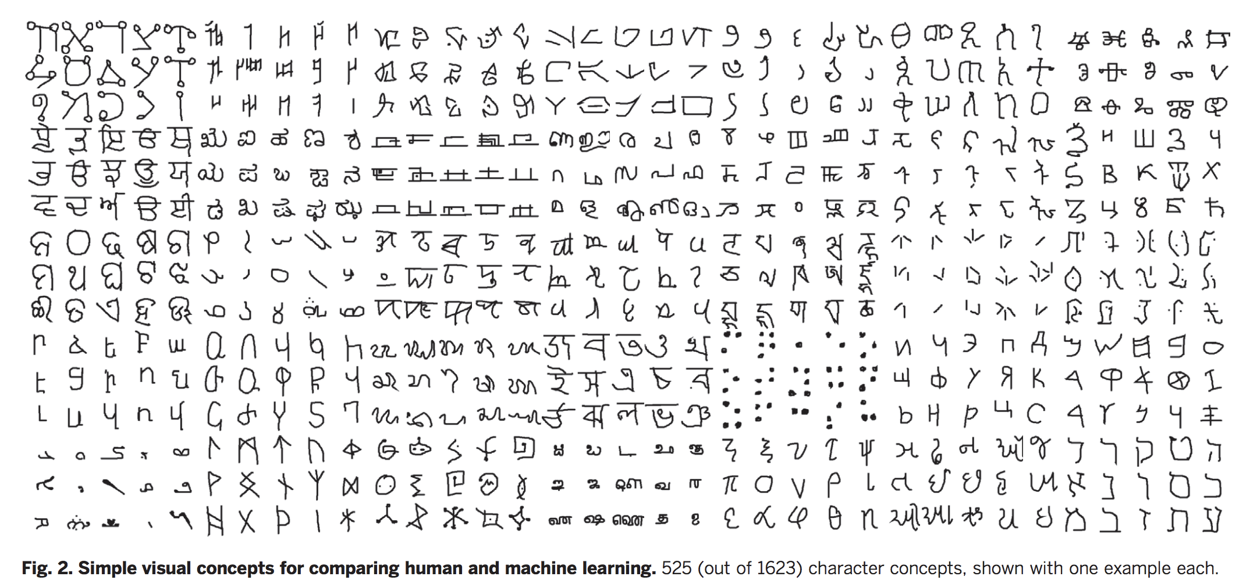
A library of visual concepts

Slide 55
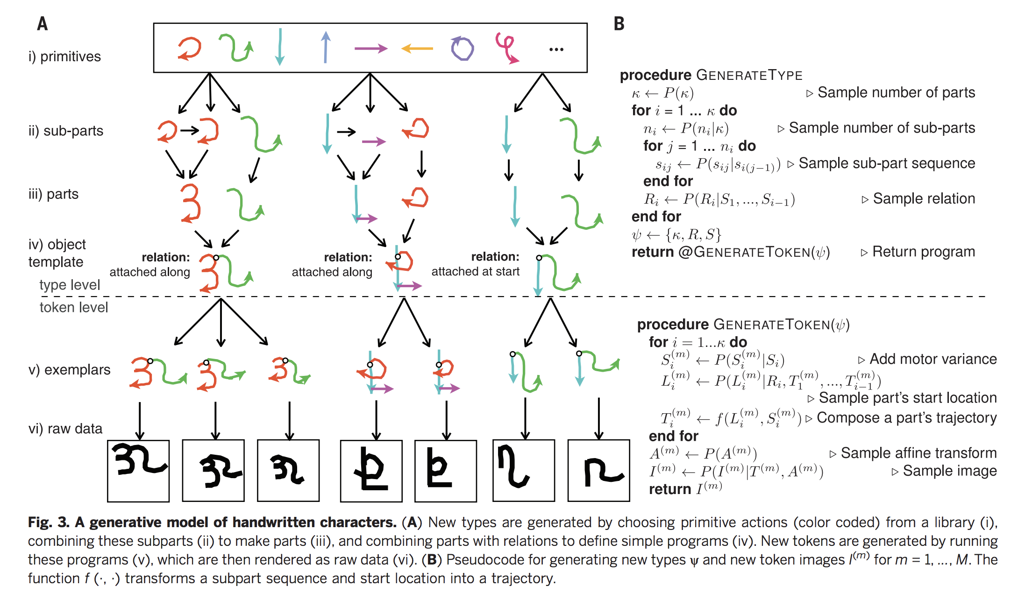
A generative “language” for characters

Slide 56
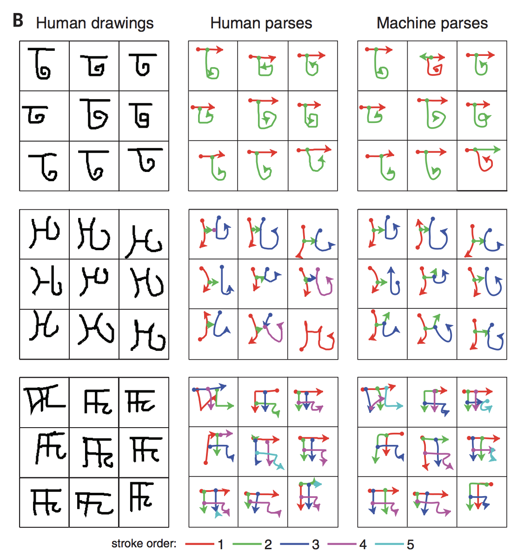
Grammar allows structure learning

Slide 57
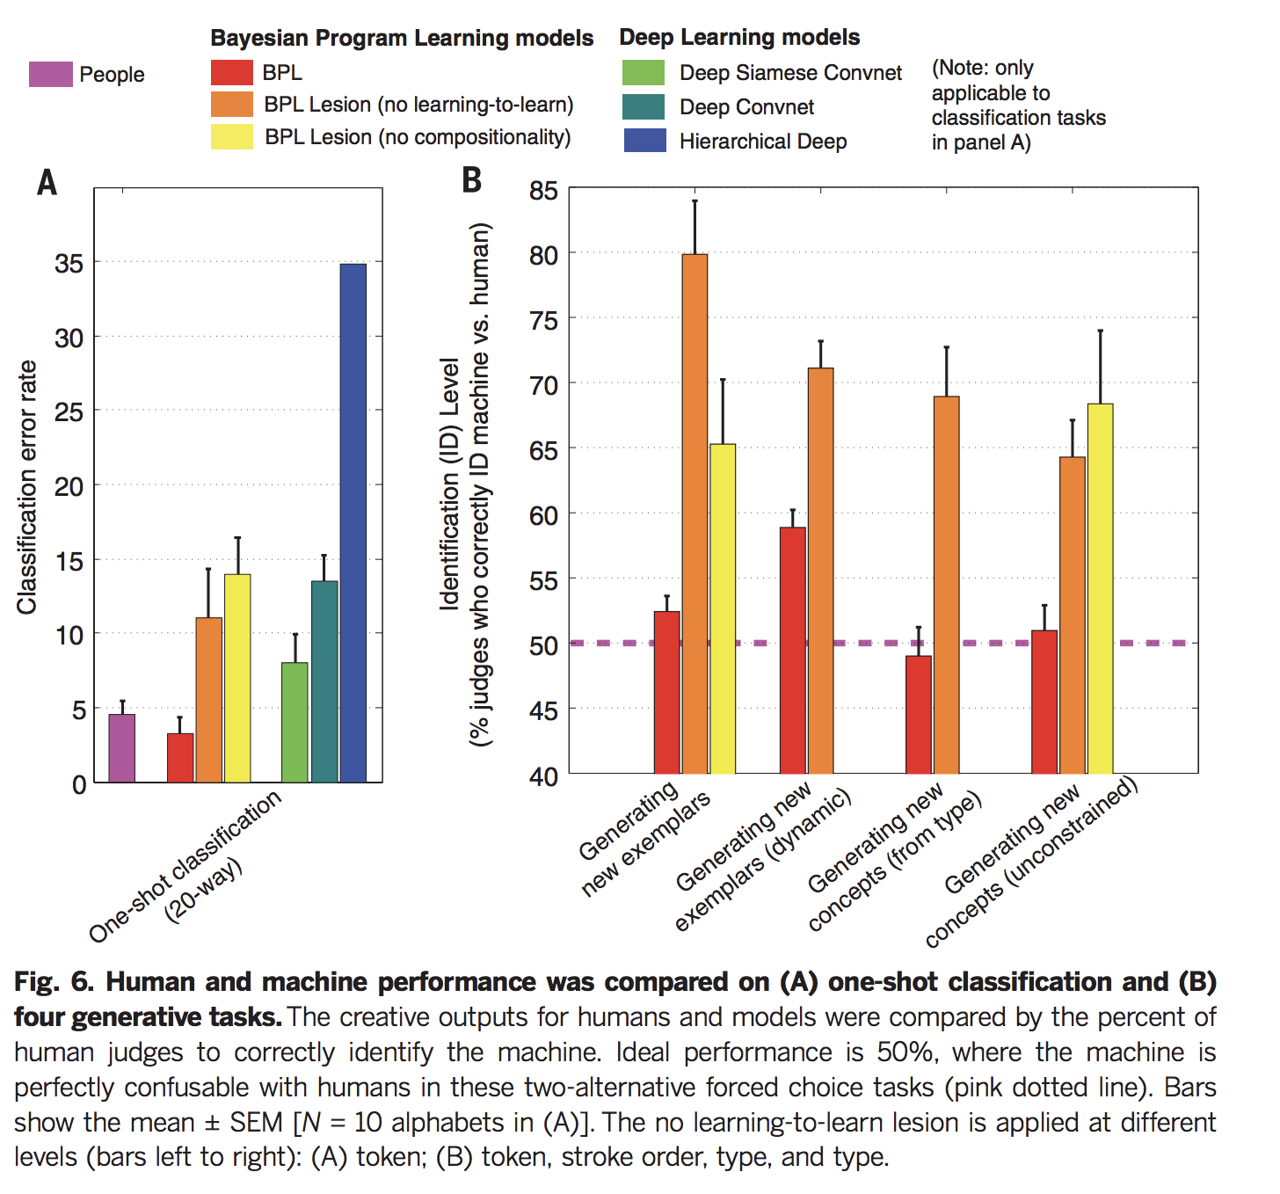
Structure allows smart generalization!

Slide 58
Thanks!

